Slide 1

BANGLADESH ARMY UNIVERSITY OF SCIENCE & TECHNOLOGY(BAUST)
Department of Computer Science and Engineering (CSE)
Course Title: Object Machine Learning Sessional
Title: Employee Churn Prediction
Course Code: CSE 4142
PRESENTED TO:
Engr. Rohul Amin
LECTURER, CSE, BAUST
Nadim Reza
LECTURER, CSE, BAUST
PRESENTED BY:
ARIFUL ISLAM NOBIN
ID: 220201077

Slide 2
Employee Churn Prediction Using Machine Learning
A Comprehensive Comparative Analysis

Slide 3
📋 Key concepts
Introduction
Research Objectives
Related Work Summary
Dataset Overview
Methodology
Experimental Results
Key Findings
Conclusion & Future Work

Slide 4
🎯 Introduction
Definition
Employee turnover, the process by which employees leave an organization, is a critical issue that impacts productivity, morale, and organizational costs. High turnover rates lead to increased recruitment and training expenses and can disrupt workflow and business continuity.

Slide 5
The Problem
Employee turnover costs organizations 50%-200% of annual salary per employee
Leads to decreased productivity, knowledge loss, and reduced morale

Slide 6
Research Objectives
Develop Comprehensive ML Framework
  Address severe class imbalance (4.79:1 ratio)
Compare Balancing Techniques
Evaluate Classification Algorithms (5 models)
Identify Optimal Combination
Maximize F1-Score and Recall
Focus on catching employees who will quit

Slide 7
Related work
Study | Dataset Size | Algorithms | Balancing | Best F1/Accuracy
Musanga & Chibaya (2023) | IBM HR | RF, GB, DT, LR, KNN | SMOTE, Oversampling | 92.57% accuracy
Klop (2021) | Financial data | XGBoost, RF, GB | N/A | XGBoost best
Fekete & Rozenberg (2014) | Manufacturing | Performance model, GB, RF | N/A | Evaluation framework
This Study | 11,582 employees | RF, GB, DT, LR, KNN | 4 methods tested | F1: 0.9508 (98.45%)

Slide 8
DATASET OVERVIEW
Total Records: 11,582 employees
Features: 10 input features → 17 after encoding
Category | Features | Type
Performance | satisfaction_level, last_evaluation | Continuous (0-1)
Workload | number_project, average_monthly_hours | Numeric
Tenure | time_spend_company | Years
Career | Work_accident, promotion_last_5years | Binary
Demographics | department (10 categories), salary (3 levels) | Categorical

Slide 9
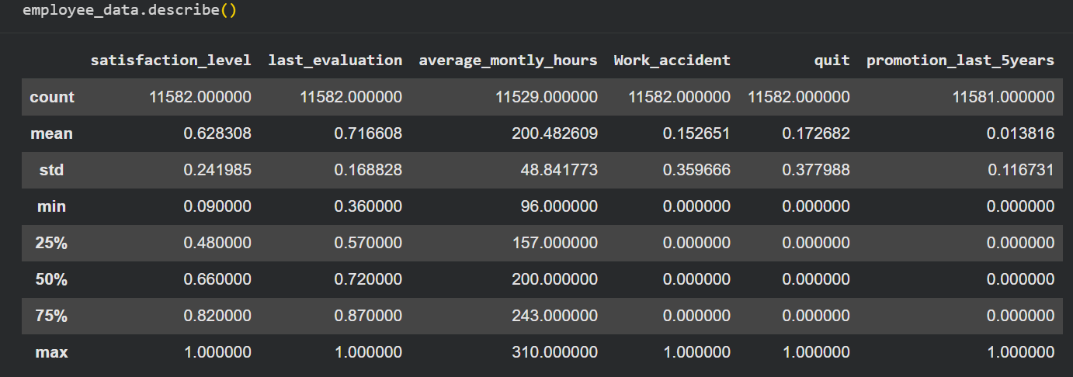
Data description

Slide 10
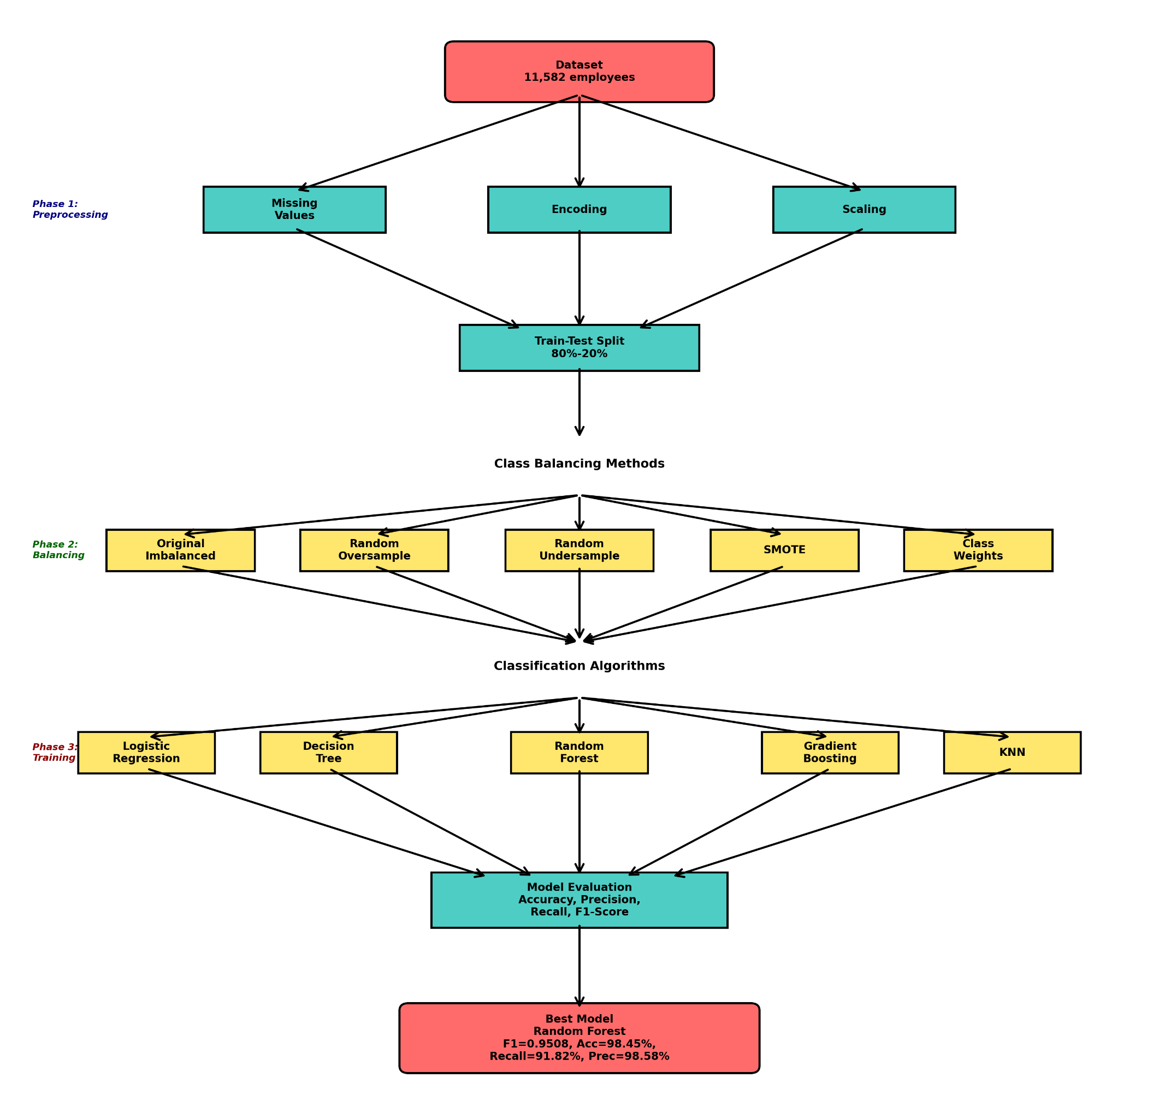
Methodology

Slide 11
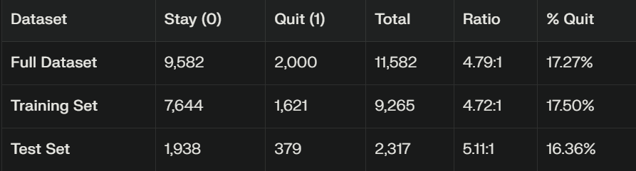
CLASS Balancing - THE CORE CHALLENGE
Naive "always predict Stay" → 82.73% accuracy without learning
Standard accuracy metric is misleading
Need balanced metrics: Precision, Recall, F1-Score
Missing a quitter (False Negative) > False alarm (False Positive)

Slide 12
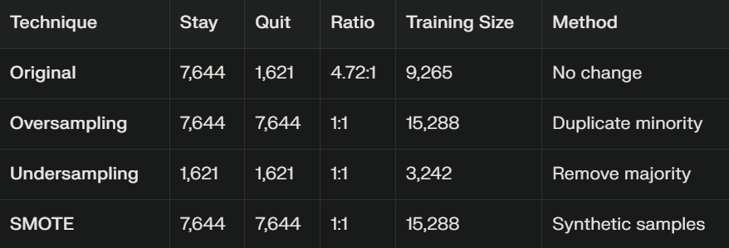
BALANCING TECHNIQUES

Slide 13
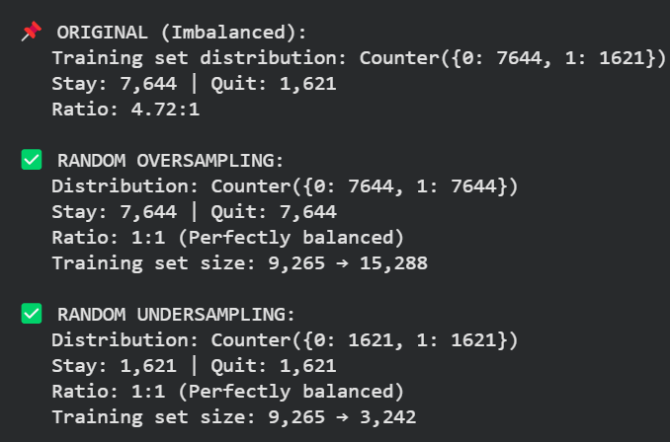
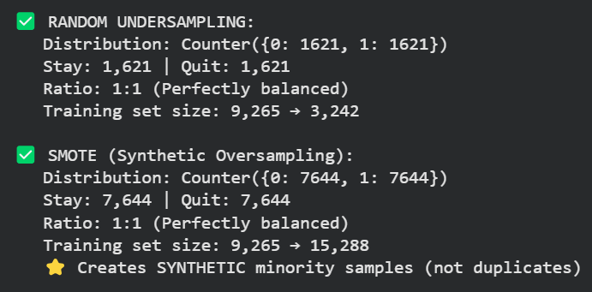
BALANCING TECHNIQUES

Slide 14
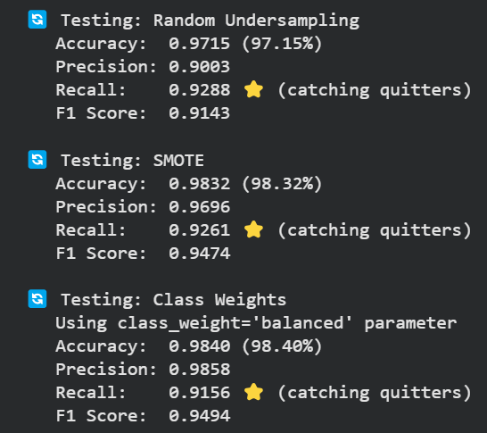
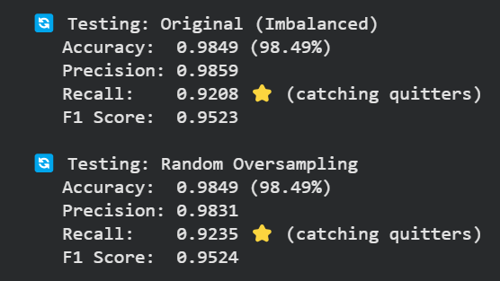
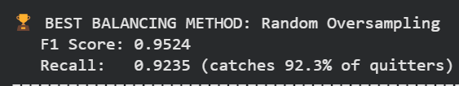
After BALANCING TECHNIQUES

Slide 15
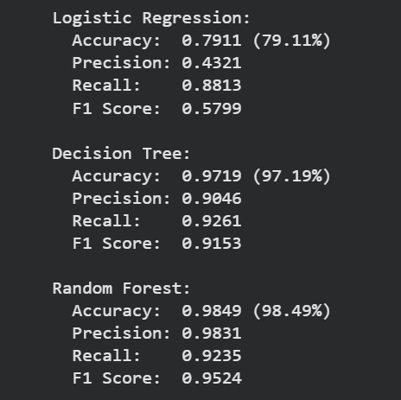
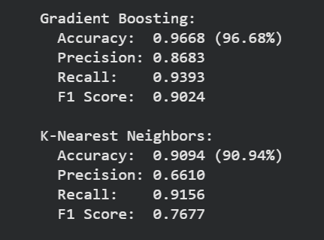
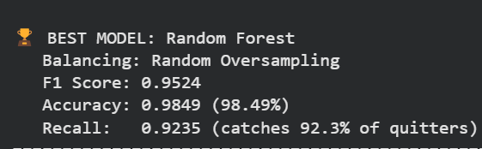
After training With different models

Slide 16
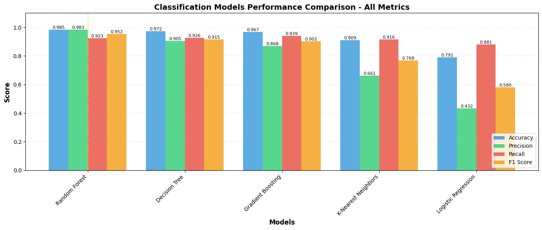
After training With different models

Slide 17
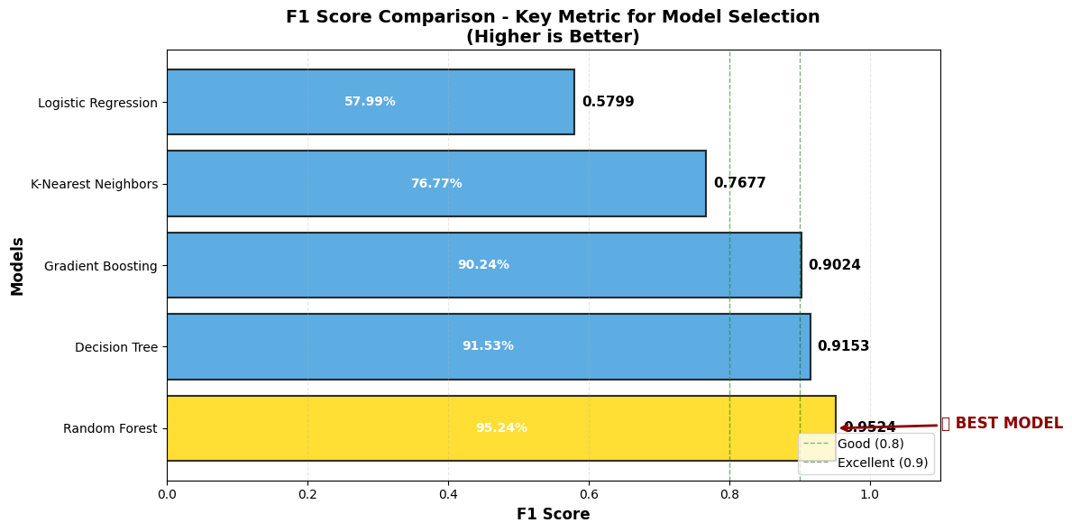
After training With different models

Slide 18
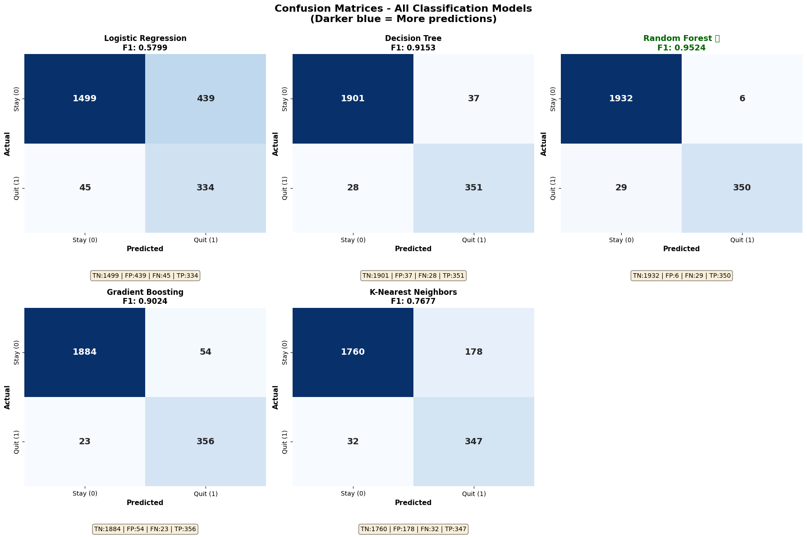
Confusion matrix
TN (True Negative): Correctly predicted STAY FP
FP(False Positive): Predicted QUIT but actually STAY (false alarm)
FN (False Negative): Predicted STAY but actually QUIT (missed quitter)
TP (True Positive): Correctly predicted QUIT

Slide 19
After training With different models

Slide 20
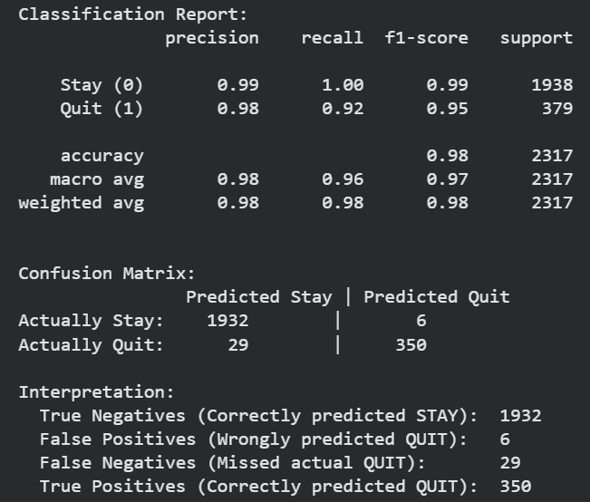
Classification report
Random forest

Slide 21
Future Work
Feature engineering (add domain-specific features)
Deep learning approaches
Multi-dataset validation
Real-world deployment & ROI measurement
Fairness & bias analysis

Slide 22
References
V. Musanga and C. Chibaya, “A predictive model to forecast employee churn for HR analytics,” in DigitalSkills2023, EPiC Series in Education Science, vol. 5, 2023, pp. 17-30.
G. Klop, “Predicting employee turnover and reducing turnover costs using machine learning techniques,” M.S. thesis, Eindhoven University of Technology, Netherlands, 2021.
M. Fekete and I. Rozenberg, “The practical model of employee performance evaluation,” Management, vol. 14, no. 2, pp. 141-158, 2014.
N. V. Chawla, K. W. Bowyer, L. O. Hall, and W. P. Kegelmeyer, “SMOTE: synthetic minority over-sampling technique,” Journal of Artificial Intelligence Research, vol. 16, pp. 321-357, 2002.
H. He and E. A. Garcia, “Learning from imbalanced data,” IEEE Transactions on Knowledge and Data Engineering, vol. 21, no. 9, pp. 1263-1284, 2009.

Slide 23
Thank you
ANY QUESTIONS?

